Slide 1
Computer Forensics: Basics
Lecture 1
The Context of Computer Forensics
Adapted from a lecture by Mark Rogers
Purdue University 2004

Slide 2
Debate
Is digital forensics a “real” scientific discipline?
  What is digital forensics
  How do you define a scientific discipline?
  Does it really matter?

Slide 3
Learning Objectives
At the end of this section you will be able to:
  Describe the science of digital forensics.
  Categorize the different communities and areas within digital forensics.
  Explain where computer forensics fits into DFS
  Describe criminalistics as it relates to the investigative process
  Discuss the 3 A’s of the computer forensics methodology
  Critically analyze the emerging area of cyber-criminalistics
  Explain the holistic approach to cyber-forensics
Notes:
Remember to use anecdotes, and place important concepts on the black board!

Slide 4
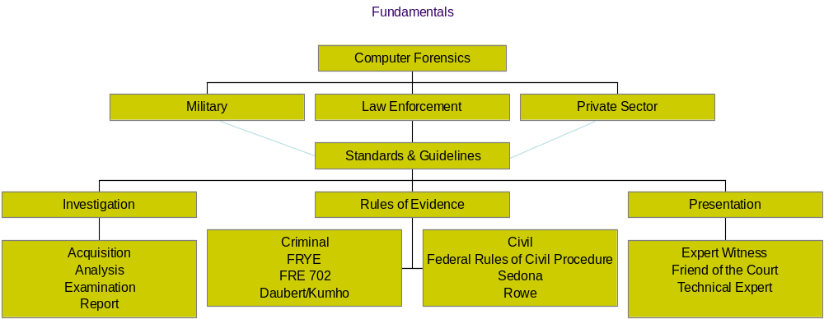
Computer Forensics

Slide 5
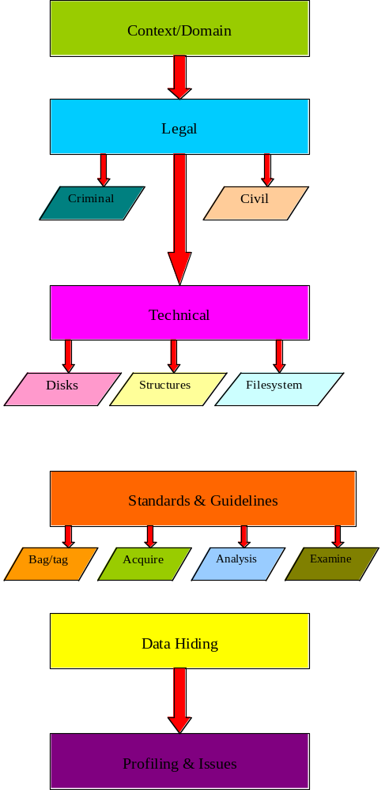
Concept Map

Slide 6
Criminalistics

Slide 7
Criminalistics
Fancy term for Forensic Science
Forensic Science
  The application of science to those criminal and civil laws that are enforced by police agencies in a criminal justice system (Saferstein, 2004)
Think Sherlock Holmes!!

Slide 8
History & Development
Francis Galton (1822-1911)
  First definitive study of fingerprints
Sir Arthur Conan Doyle (1887)
  Sherlock Holmes mysteries
Leone Lattes (1887-1954)
  Discovered blood groupings (A,B,AB, & 0)
Calvin Goddard (1891-1955)
  Firearms and bullet comparison
Albert Osborn (1858-1946)
  Developed principles of document examination
Hans Gross (1847-1915)
  First treatise on using scientific disciplines in criminal investigations.

Slide 9
History & Development
Edmond Locard (1877-1966)
  Principle of Exchange
    “..when a person commits a crime something is always left at the scene of the crime that was not present when the person arrived.”
  The purpose of an investigation is to locate identify and preserve evidence-data on which a judgment or conclusion can be based.
FBI (1932)
  National Lab to provide forensic services to all law enforcement agencies in the country
Notes:
Write Principle of Exchange on the Board

Slide 10
Crime Lab
Basic services provided
  Physical Science Unit
    Chemistry, physics, geology
  Biology Unit
    DNA, blood, hair & fiber, body fluids, botanical
  Firearms Unit
  Document Examination
  Photography Unit

Slide 11
Crime Lab
Optional Services
  Toxicology Unit
  Latent Fingerprint Unit
  Polygraph Unit
  Voice Print Analysis Unit
  Evidence Collection Unit (Rather new)

Slide 12
Other Forensic Science Services
Forensic Pathology
  Sudden unnatural or violent deaths
Forensic Anthropology
  Identification of human skeletal remains
Forensic Entomology
  Insects
Forensic Psychiatry
Forensic Psychology
Forensic Odontology
  Dental
Forensic Engineering
***Digital Forensics***

Slide 13
Digital Forensic Science
Digital Forensic Science (DFS):
  “The use of scientifically derived and proven methods toward the preservation, collection, validation, identification, analysis, interpretation, documentation and presentation of digital evidence derived from digital sources for the purpose of facilitating or furthering the reconstruction of events found to be criminal, or helping to anticipate unauthorized actions shown to be disruptive to planned operations.”
  Source: (2001). Digital Forensic Research Workshop (DFRWS)
Notes:
On board:
preservation, collection, validation, identification, analysis, interpretation, documentation and presentation

Slide 14
Communities
There at least 3 distinct communities within Digital Forensics
  Law Enforcement
  Military
  Business & Industry
    Possibly a 4th – Academia
Notes:
List on the board.

Slide 15
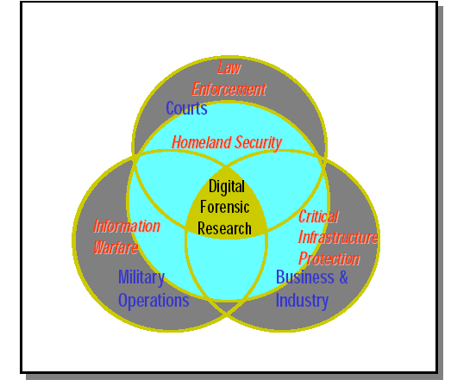
Digital Forensic Science

Slide 16
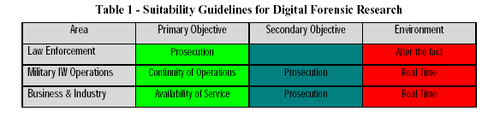
Community Objectives

Slide 17
The Process
The primary activities of DFS are investigative in nature.
The investigative process encompasses
  Identification
  Preservation
  Collection
  Examination
  Analysis
  Presentation
  Decision

Slide 18
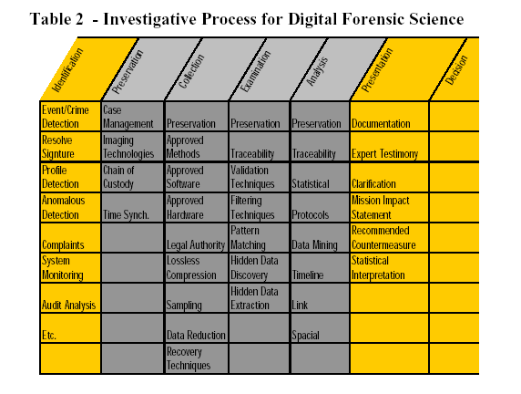
Investigative Process

Slide 19
Subcategories of DFS
There is a consensus that there are at least 3 distinct types of DFS analysis
  Media Analysis
    Examining physical media for evidence
  Code Analysis
    Review of software for malicious signatures
  Network Analysis
    Scrutinize network traffic and logs to identify and locate
Notes:
On board
Analysis:
Media
Code
Network

Slide 20
Media Analysis
May often be referred to as computer forensics.
More accurate to call it media analysis as the focus is on the various storage medium (e.g., hard drives, RAM, flash memory, PDAs, diskettes etc.)
Excludes network analysis.

Slide 21
Computer Forensics
Computer forensics is the scientific examination and analysis of data held on, or retrieved from, computer storage media in such a way that the information can be used as evidence in a court of law.
Notes:
What are the important components?

Slide 22
Computer Forensic Activities
Computer forensics activities commonly include:
  the secure collection of computer data
  the identification of suspect data
  the examination of suspect data to determine details such as origin and content
  the presentation of computer-based information to courts of law
  the application of a country's laws to computer practice.
Notes:
Application of laws very NB. Discuss this.

Slide 23
The 3 As
The basic methodology consists of the 3 As:
  Acquire the evidence without altering or damaging the original
  Authenticate the image
  Analyze the data without modifying it
Notes:
Why are these so importnat

Slide 24
Computer Forensics - History
1984 FBI Computer Analysis and Response Team (CART)
1991 International Law Enforcement meeting to discuss computer forensics & the need for standardized approach
1997 Scientific Working Group on Digital Evidence (SWGDE) established to develop standards
2001 Digital Forensic Research Workshop (DFRWS) development of research roadmap
2003 Still no standards developed or corpus of knowledge (CK)

Slide 25
Context of Computer Forensics
Computer Forensics
Homeland Security
Information Security
Corporate Espionage
White Collar Crime
Child Pornography
Traditional Crime
Incident Response
Employee Monitoring
Privacy Issues
????
Digital Forensics

Slide 26
Fit with Information Assurance
Computer Forensics is part of the incident response (IR) capability
Forensic “friendly” procedures & processes
Proper evidence management and handling
IR is an integral part of IA

Slide 27
Incident Response Methodology (PDCAERF)
Digital Forensics/Evidence Management
Preparation
Detection
Containment
Analysis
Eradication
Recovery
Follow-up
Feed Back

Slide 28
(PDCAERF)
Preparation
  Being ready to respond
  Procedures & policies
  Resources & CSIRT creation
  Current vulnerabilities & counter-measures
Detection/Notification
  Determining if an incident or attempt has been made
  IDS
  Initial actions/reactions
  Determining the scope
  Reporting process

Slide 29
(PDCAERF)
Containment
  Limit the extent of an attack
  Mitigate the potential damage & loss
  Containment strategies
Analysis & Tracking
  How the incident occurred
  More in-depth analysis of the event
  Tracing the incident back to its source

Slide 30
(PDCAERF)
Eradication/ Repair-Recovery
  Recovering systems
  Getting rid of the causes of the incident, vulnerabilities or the residue (rootkits, trojan horses etc.)
  Hardening systems
  Dealing with patches

Slide 31
(PDCAERF)
Follow-up
  Review the incident and how it was handled
  Postmortem analysis
  Lessons learned
  Follow-up reporting

Slide 32
Challenges
Eric Holder, Deputy Attorney General of the United States Subcommittee on Crime of the House Committee on the Judiciary and the Subcommittee on Criminal Oversight of the Senate Committee on the Judiciary:
    Technical challenges that hinder law enforcement’s ability to find and prosecute criminals operating online;
    Legal challenges resulting from laws and legal tools needed to investigate cybercrime lagging behind technological, structural, social changes; and
    Resource challenges to ensure we have satisfied critical investigative and prosecutorial needs at all levels of government.
Notes:
Technical
Legal
Resource

Slide 33
Challenges
NIJ 2001 Study
    There is near-term window of opportunity for law enforcement to gain a foothold in containing electronic crimes.
    Most State and local law enforcement agencies report that they lack adequate training, equipment and staff to meet their present and future needs to combat electronic crime.
    Greater awareness of electronic crime should be promoted for all stakeholders, including prosecutors, judges, academia, industry, and the general public.

Slide 34
General Challenges
Computer forensics is in its infancy
Different from other forensic sciences as the media that is examined and the tools/techniques for the examiner are products of a market-driven private sector
No real basic theoretical background upon which to conduct empirical hypothesis testing
No true professional designations
Proper training
At least 3 different “communities” with different demands
Still more of a “folk art” than a true science

Slide 35
Legal Challenges
Status as scientific evidence??
Criteria for admissibility of novel scientific evidence (Daubert v. Merrell)
  Whether the theory or technique has been reliably tested;
  Whether the theory or technique has been subject to peer review and publication;
  What is the known or potential rate of error of the method used; and
  Whether the theory or method has been generally accepted by the scientific community.
Kumho Tire extended the criteria to technical knowledge
Notes:
Historically
Frye
FRE 702
Daubert
Kumho Tire

Slide 36
Specific Challenges
No International Definitions of Computer Crime
No International agreements on extraditions
Multitude of OS platforms and filesystems
Incredibly large storage capacity
  100 Gig Plus
  Terabytes
  SANs

Slide 37
Specific Challenges
Small footprint storage devices
  Compact flash
  Memory sticks
  Thumb drives
  Secure digital
Networked environments
RAID systems
Grid computing
Embedded processors
Other??
Notes:
Ask the students for input here.

Slide 38
Specific Challenges
Where is the “crime scene?”
Cyberspace
Perpetrator’s
System
Victim’s
System
Electronic Crime
Scene

Slide 39
Specific Challenges
What constitutes evidence??
What are we looking for??

Slide 40
Summary
DFS is a sub-discipline of criminalistics
DFS is a relatively new science
3 Communities
  Legal, Military, Private Sector/Academic
DFS is primarily investigative in nature
DFS is made up of
  Media Analysis
  Code Analysis
  Network Analysis

Slide 41
Summary
Computer Forensics is a sub-discipline within DFS
Computer Forensics is part of an IR capability
3 A’s of the Computer Forensic Methodology
There are many general and specific challenges
There is a lack of basic research in this area
Both DFS and Computer Forensics are immature emerging areas
Notes:
1 Minute paper. Please provide a brief summary of what you consider to be the most important concept of today’s discussion.

